Slide 1
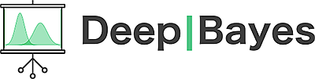


Implicit generative models
Dmitry Ulyanov^{1,2}
Deep | Bayes
Moscow, 2017
1
2

Slide 2
Outline
Vanilla GAN intuition
Distribution divergences
Learning in implicit models
Alpha GAN

Slide 3
Outline
Vanilla GAN intuition
Distribution divergences
Learning in implicit models
Alpha GAN

Slide 4
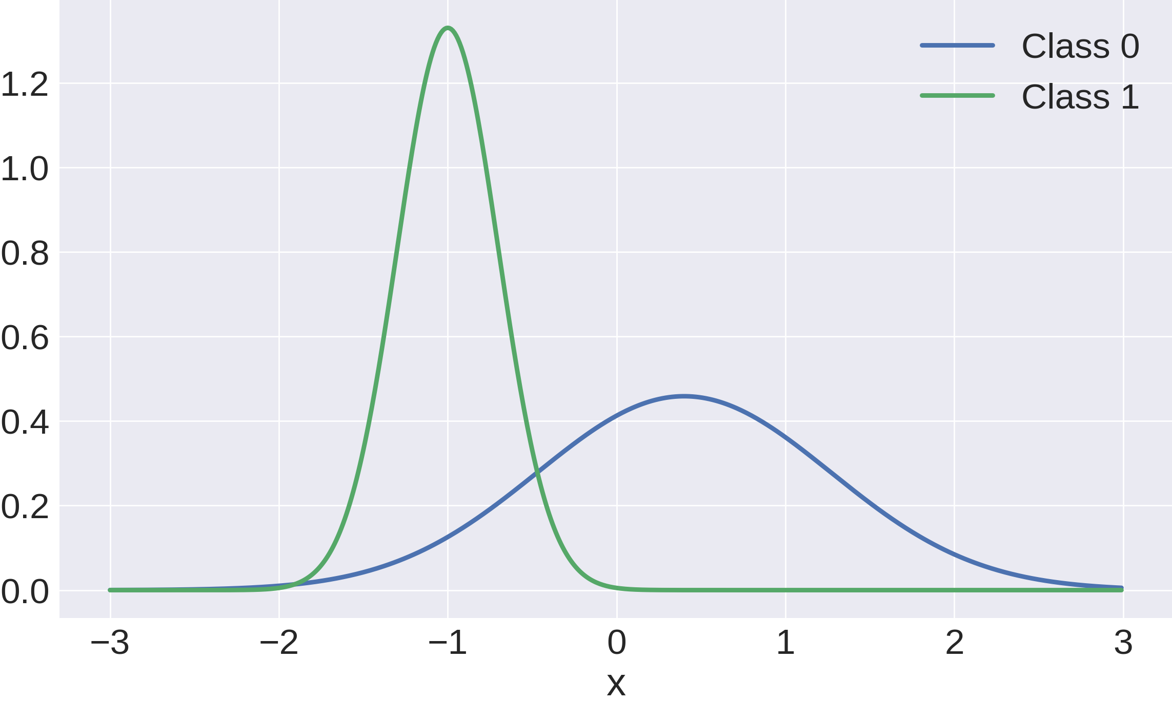
Some intuition behind implicit models

Slide 5
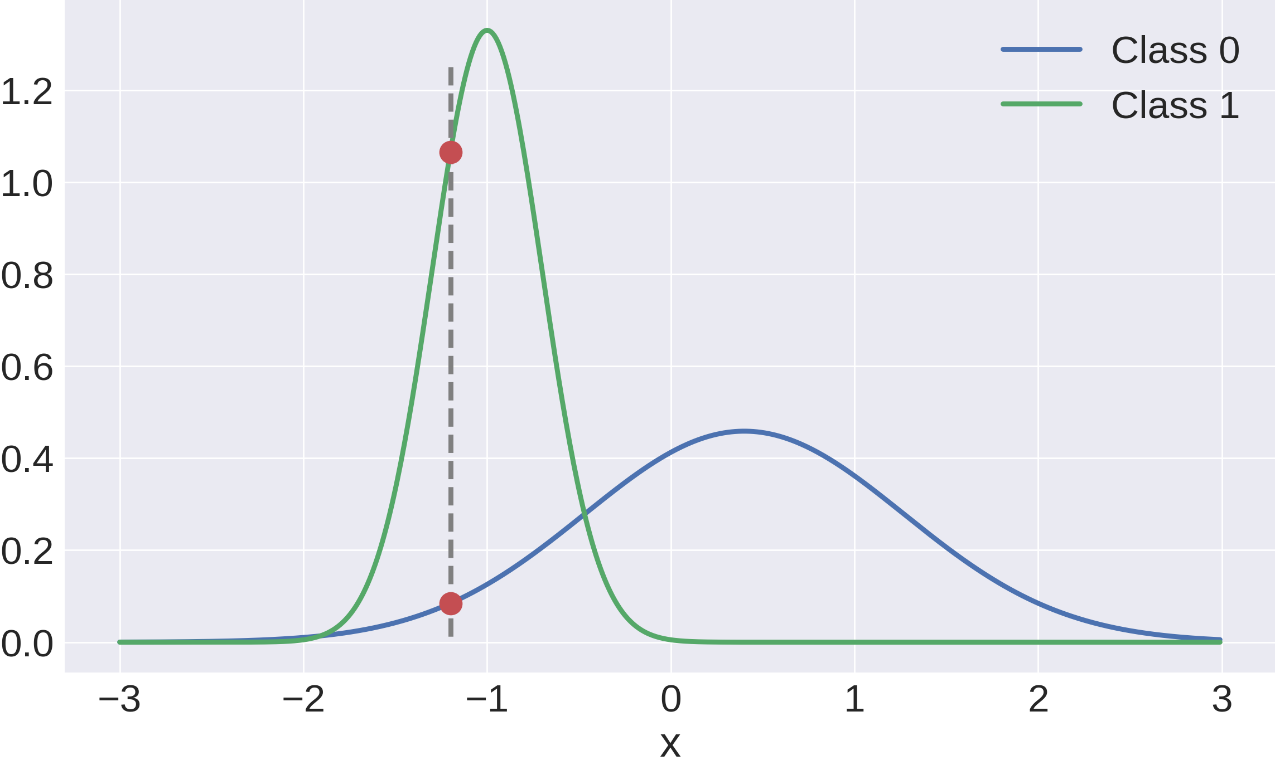
Some intuition behind implicit models

Slide 6
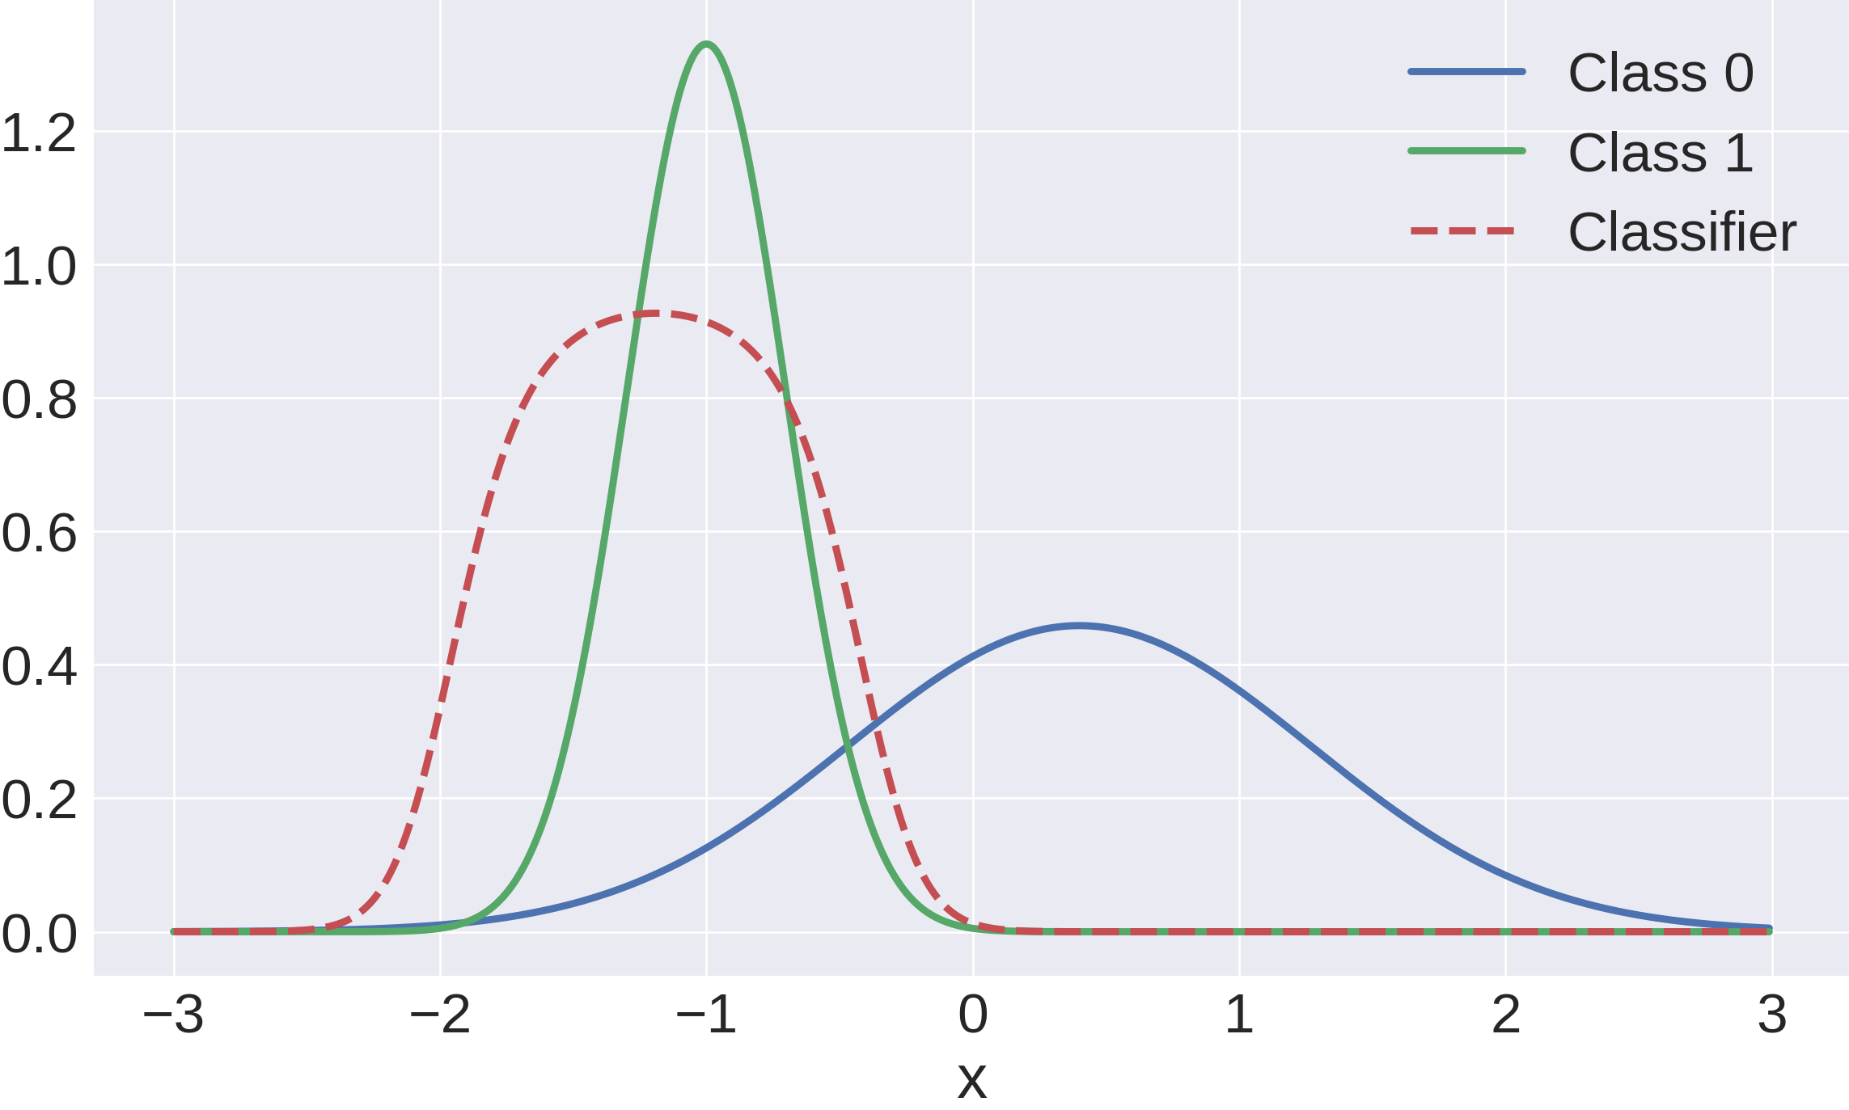
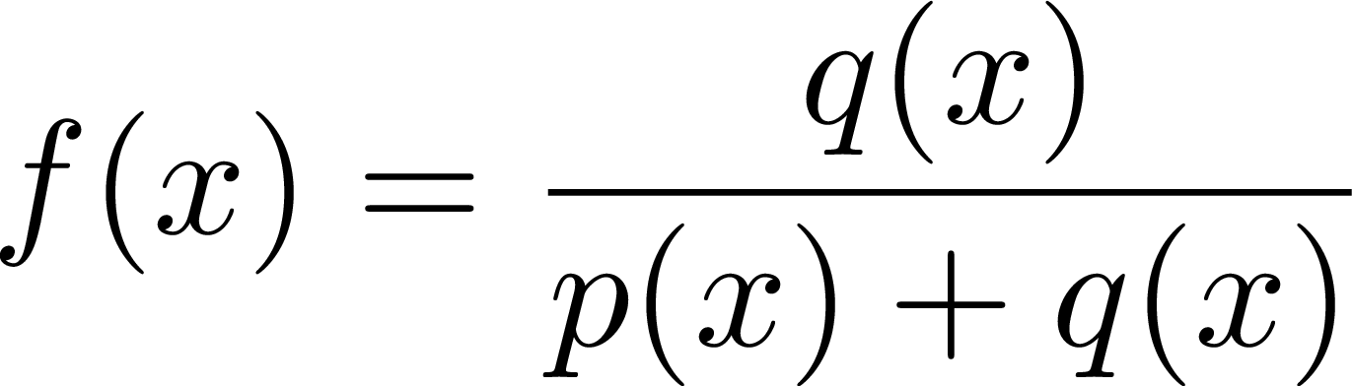
Some intuition

Slide 7
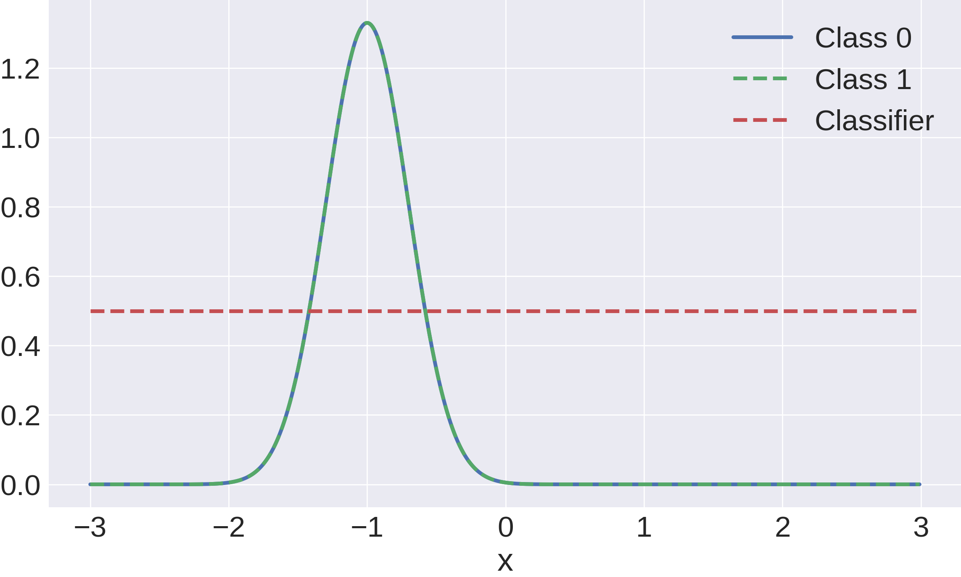
Some intuition

Slide 8
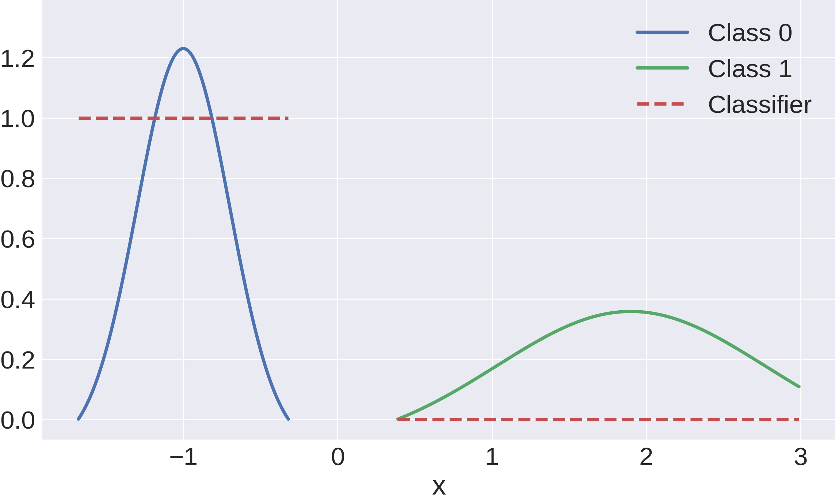
Some intuition

Slide 9
Some intuition
So far we had fixed P, Q and only trained classifier.
How do we use classifier’s output to move Q towards P?

Slide 10
Some intuition

Slide 11
Some intuition

Slide 12
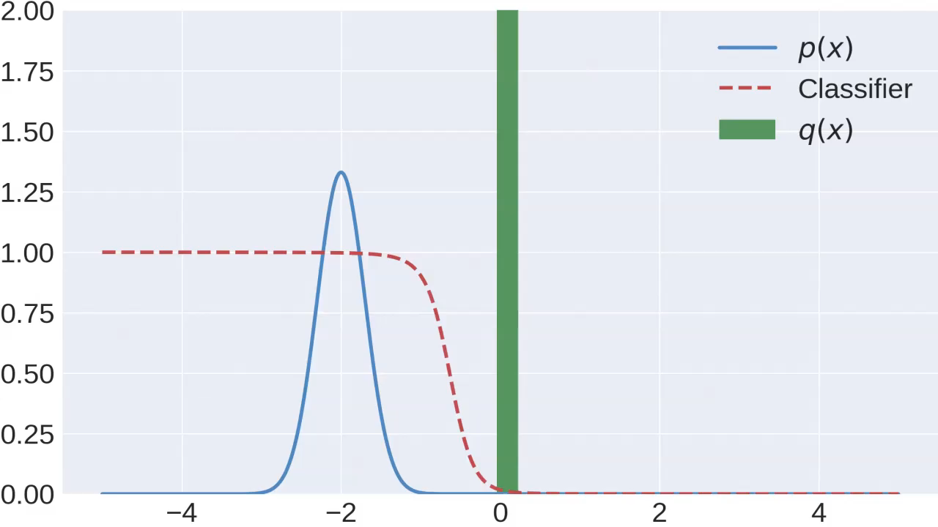
Simulation

Slide 13
A problem

Slide 14
Summary
What do we need to learn a classifier?
Only samples!
We are usually given samples from p(x)
How do we sample from q(x)?
z ~ N(0,1)
G(z) ~ q(x)
That is G(z) implicitly defines q(x)

Slide 15
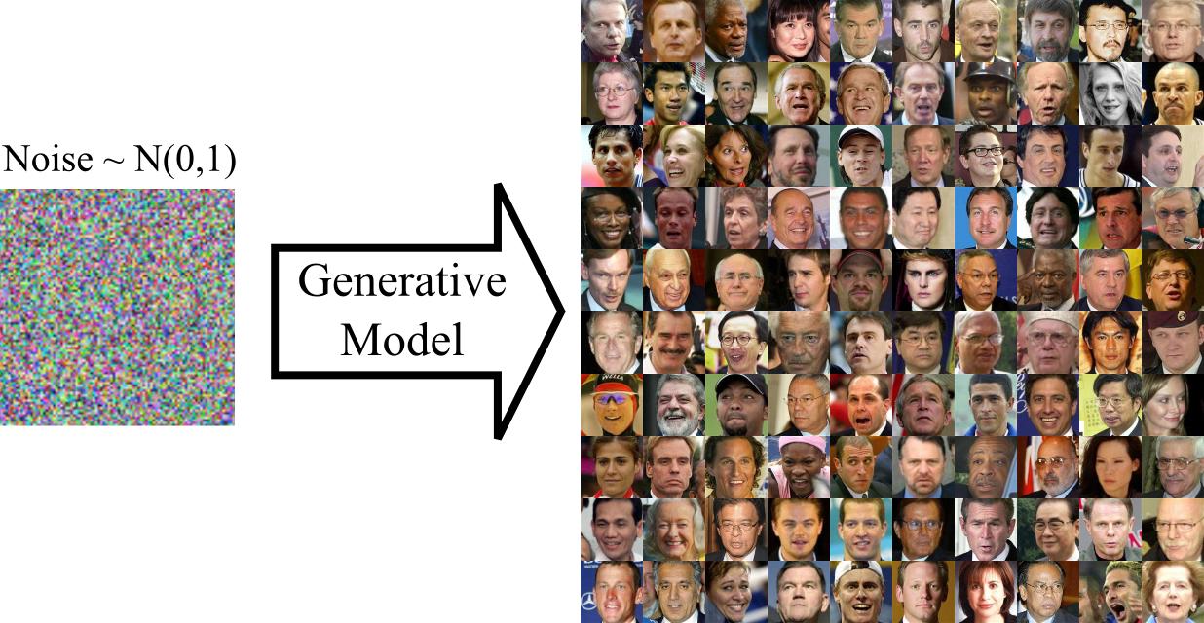
Some intuition

Slide 16
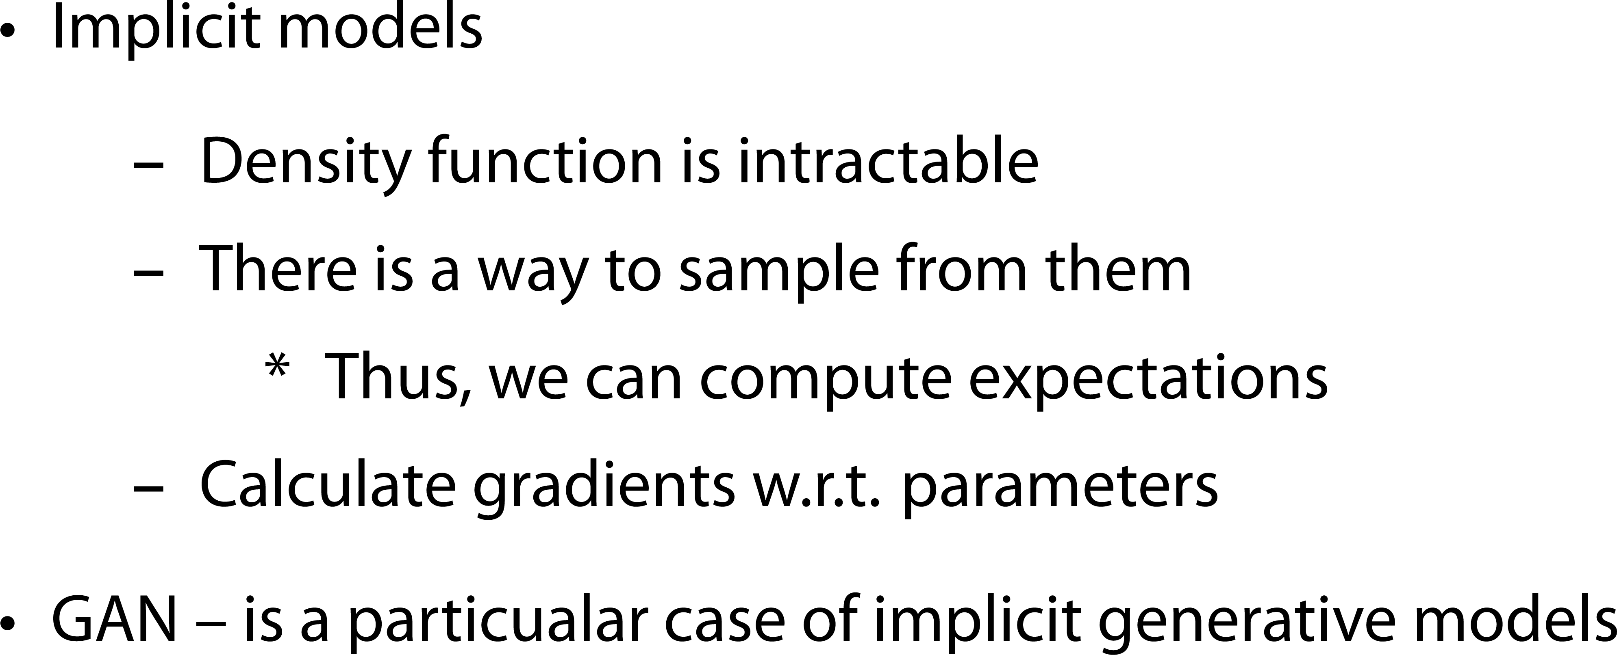
Implicit models
Notes:
Implicit distributions are probability models whose probability density function may be intractable, but there is a way to
1. sample from them exactly and/or calculate and approximate expectations under them, and
2. calculate or estimate gradients of such expectations with respect to model parameters.

Slide 17
Prescribed vs implicit models
Prescribed (think of VAE)
Implicit (think of GAN)
p(z)
p(x)
p(x | z)
p(z | x)
p(x, z)
In practice:
Sampling is not quite fair?
p(z)
Sample from p(x)
p(x) ?
p(z | x) ?
In practice:
(More) fair sampling?

Slide 18
Outline
Vanilla GAN intuition
Distribution divergences
Learning in implicit models
Alpha GAN

Slide 19
Metrics : plan
f-Divergence
Integral Probability Metrics
Optimal transport

Slide 20
Metrics : plan
f-Divergence
Integral Probability Metrics
Optimal transport

Slide 21
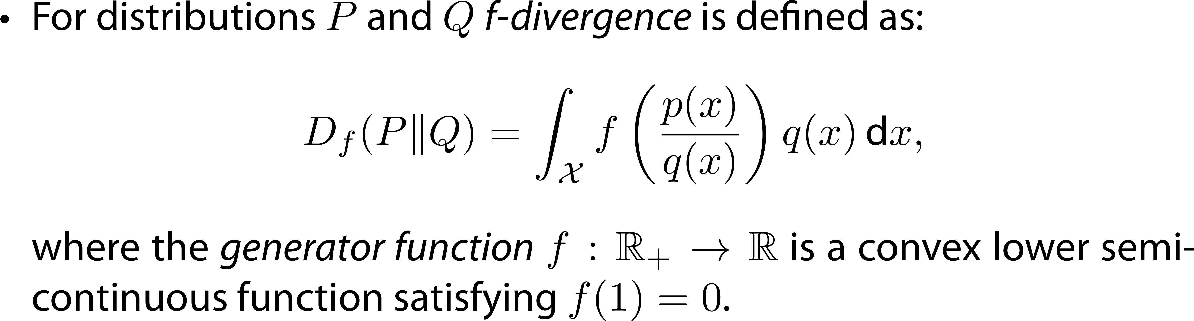
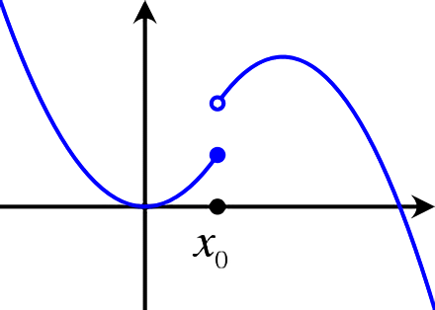
f-Divergence
Lower semi-continuous function (but non-convex)
Notes:
Замечания
1) scoring rule это …
2) Generative loss может быть другим

Slide 22
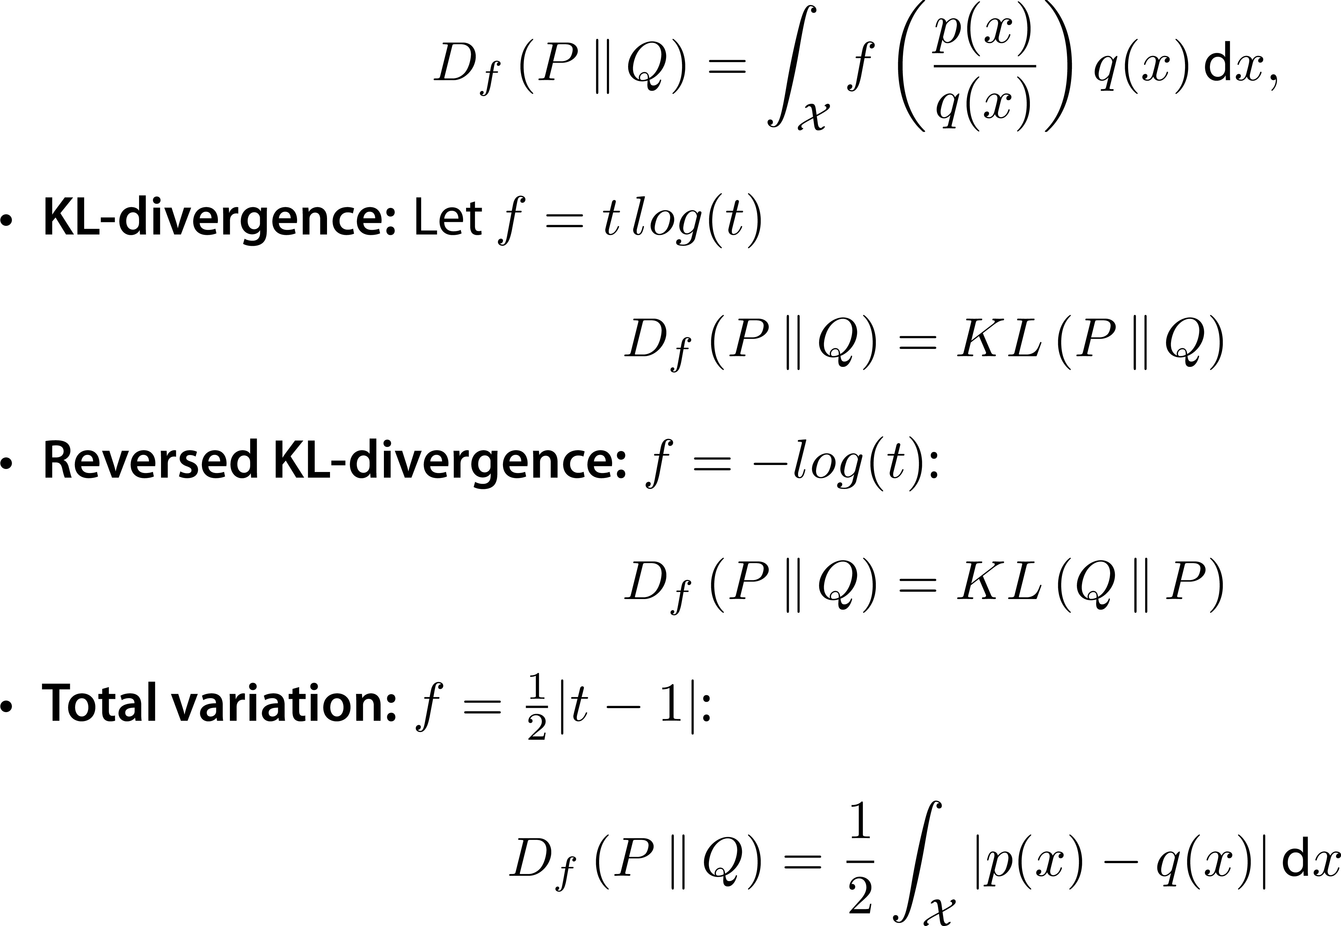
f-Divergence
Notes:
Замечания
1) scoring rule это …
2) Generative loss может быть другим

Slide 23
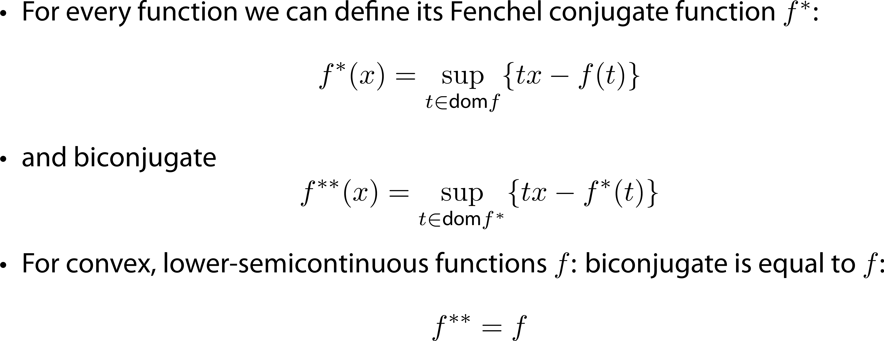
Fenchel Conjugate
Notes:
Выпуклое сопряжение
Ищем U(t)

Slide 24
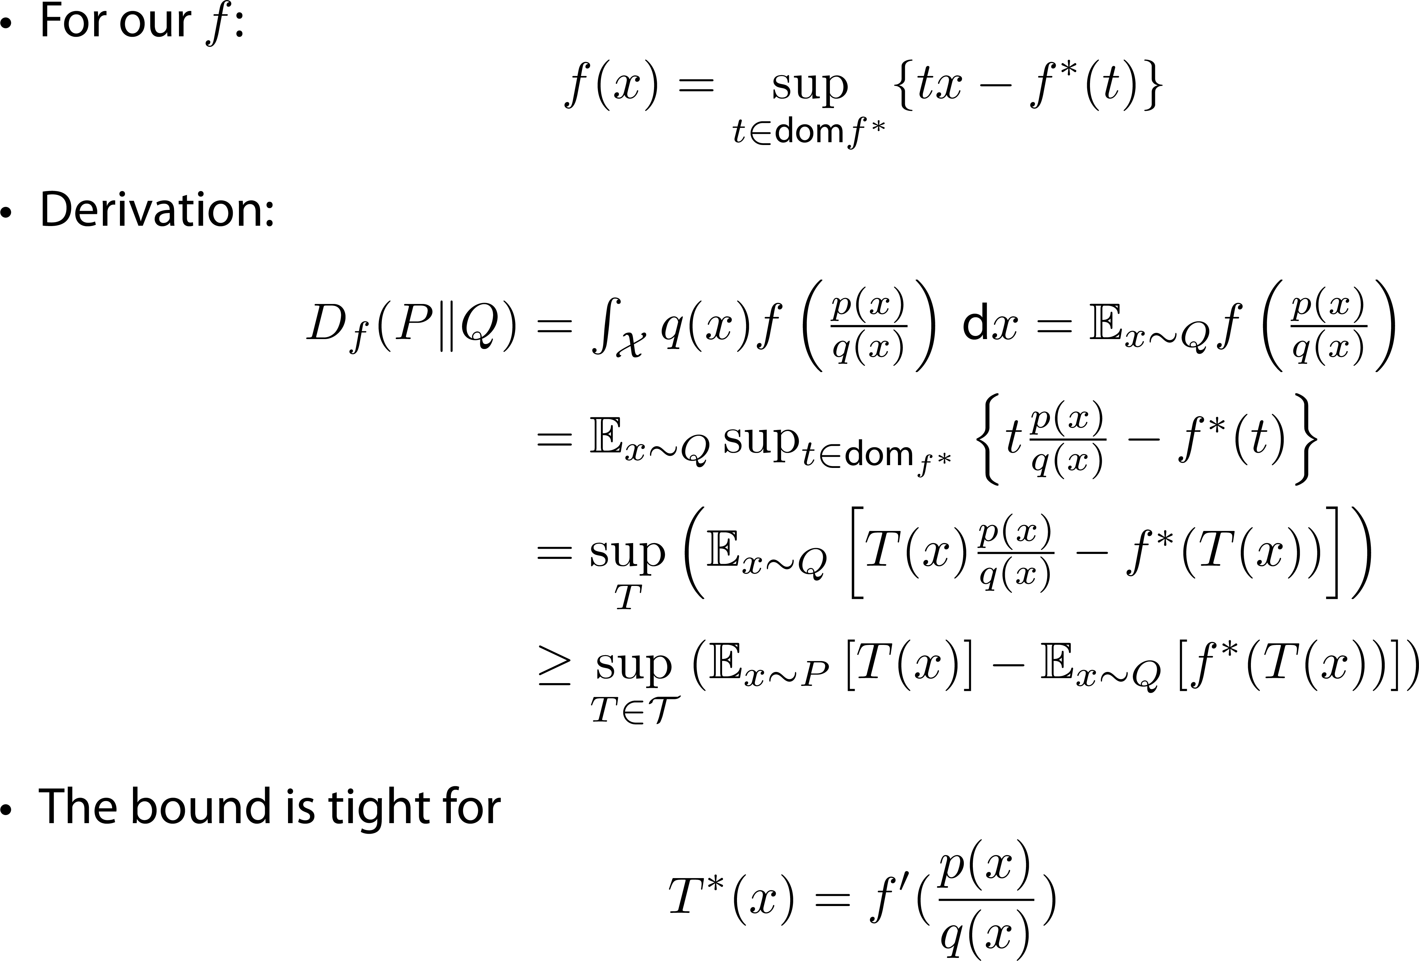
f-Divergence dual form
Notes:
Замечания
1) scoring rule это …
2) Generative loss может быть другим
Выпуклое сопряжение

Slide 25
Metrics: plan
f-Divergence
Integral Probability Metrics
Optimal transport

Slide 26
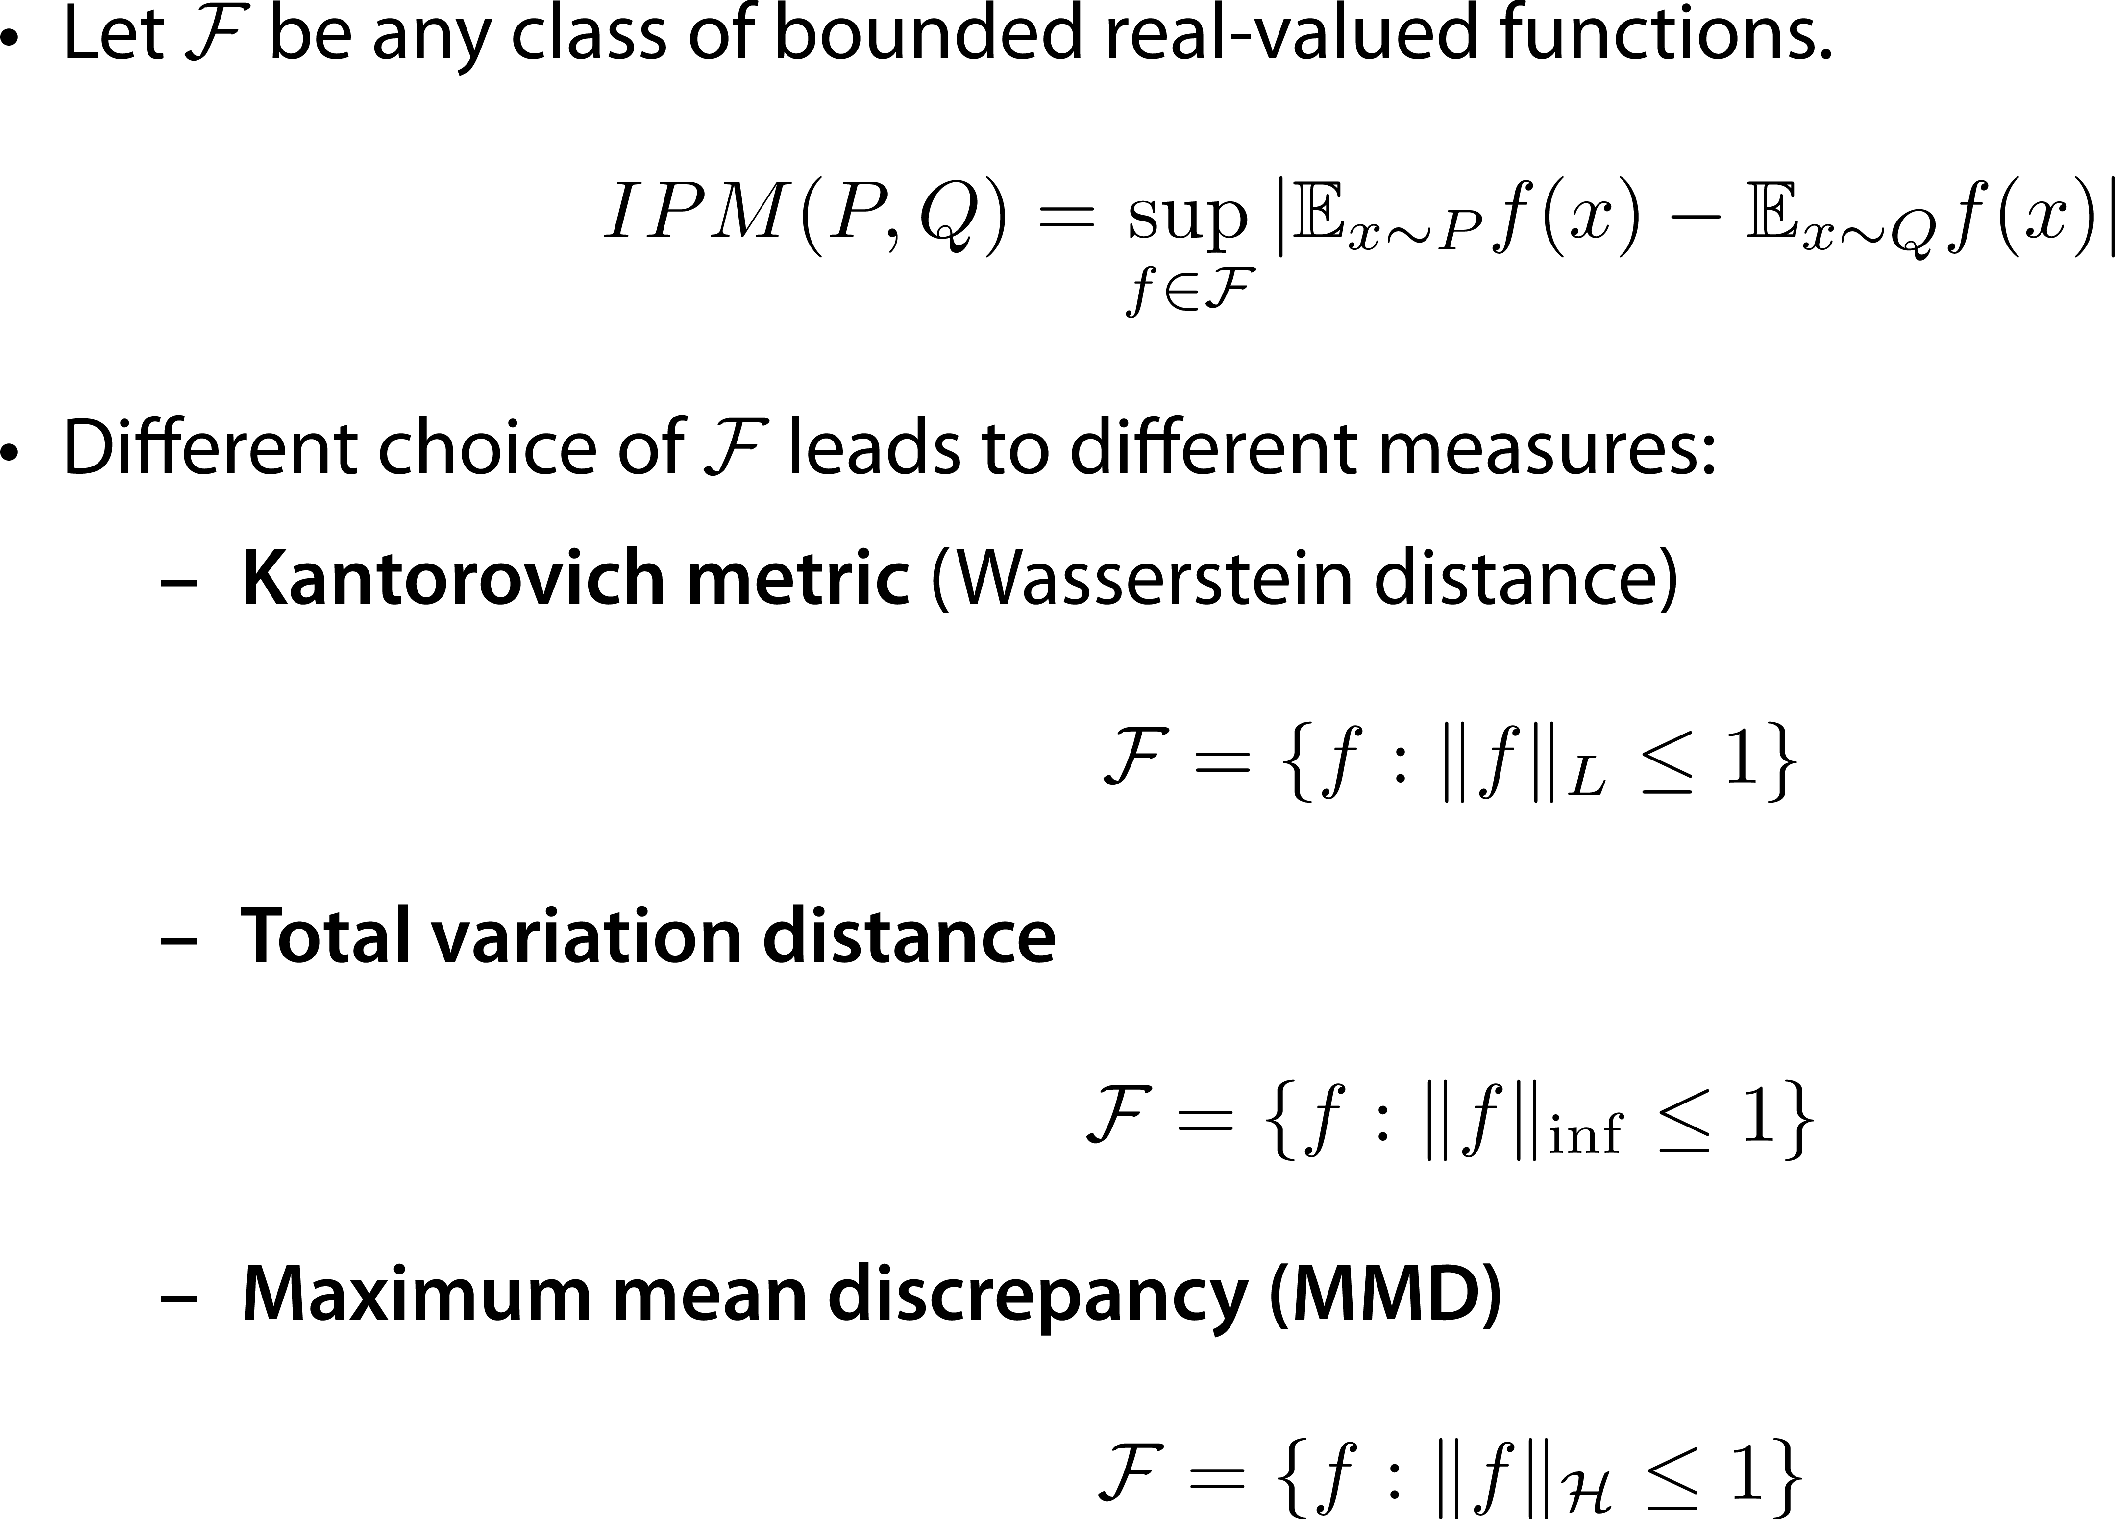
Integral Probability Metrics (IPM)
Notes:
Подумать, когда можно модуль снять?

Slide 27
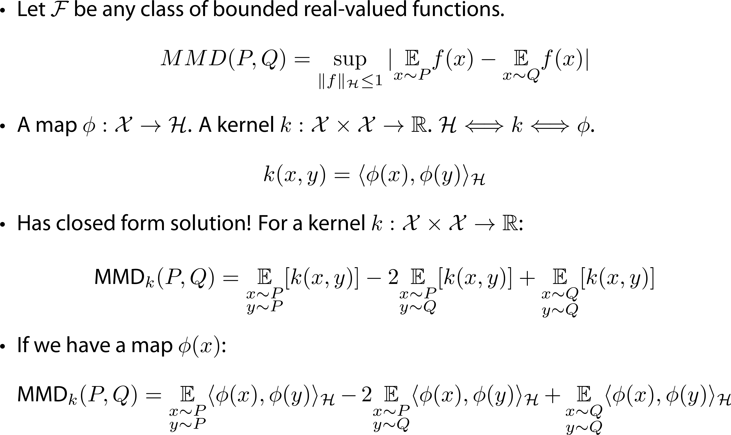
MMD
Notes:
K(x,y) = <>
MMD ⬄ kernel ⬄ dd

Slide 28
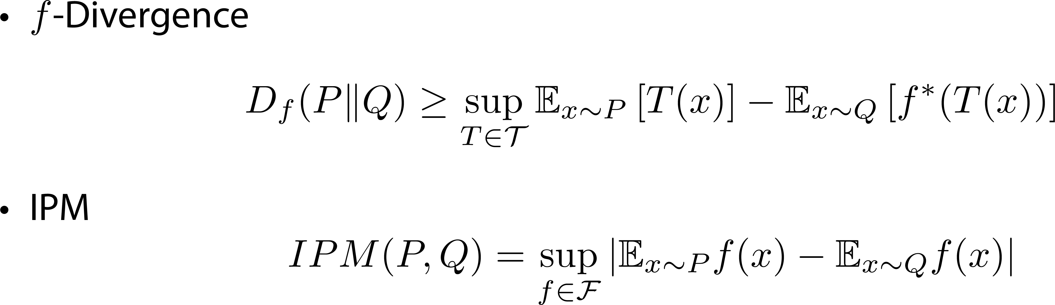
f-Divergence vs IPM
Notes:
Замечания
1) scoring rule это …
2) Generative loss может быть другим

Slide 29
Metrics : plan
f-Divergence
Integral Probability Metrics
Optimal transport

Slide 30
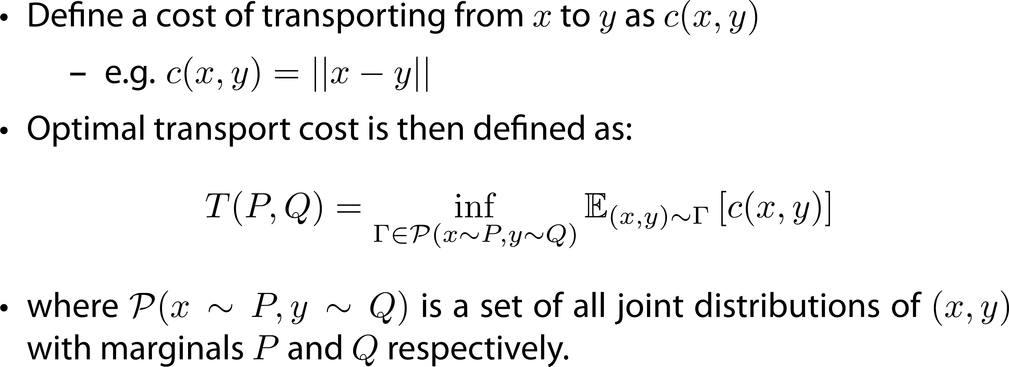
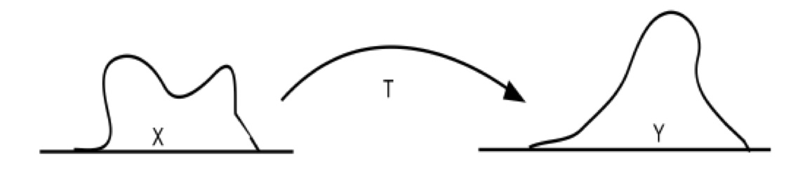
Optimal transport
Notes:
Замечания
1) scoring rule это …
2) Generative loss может быть другим

Slide 31
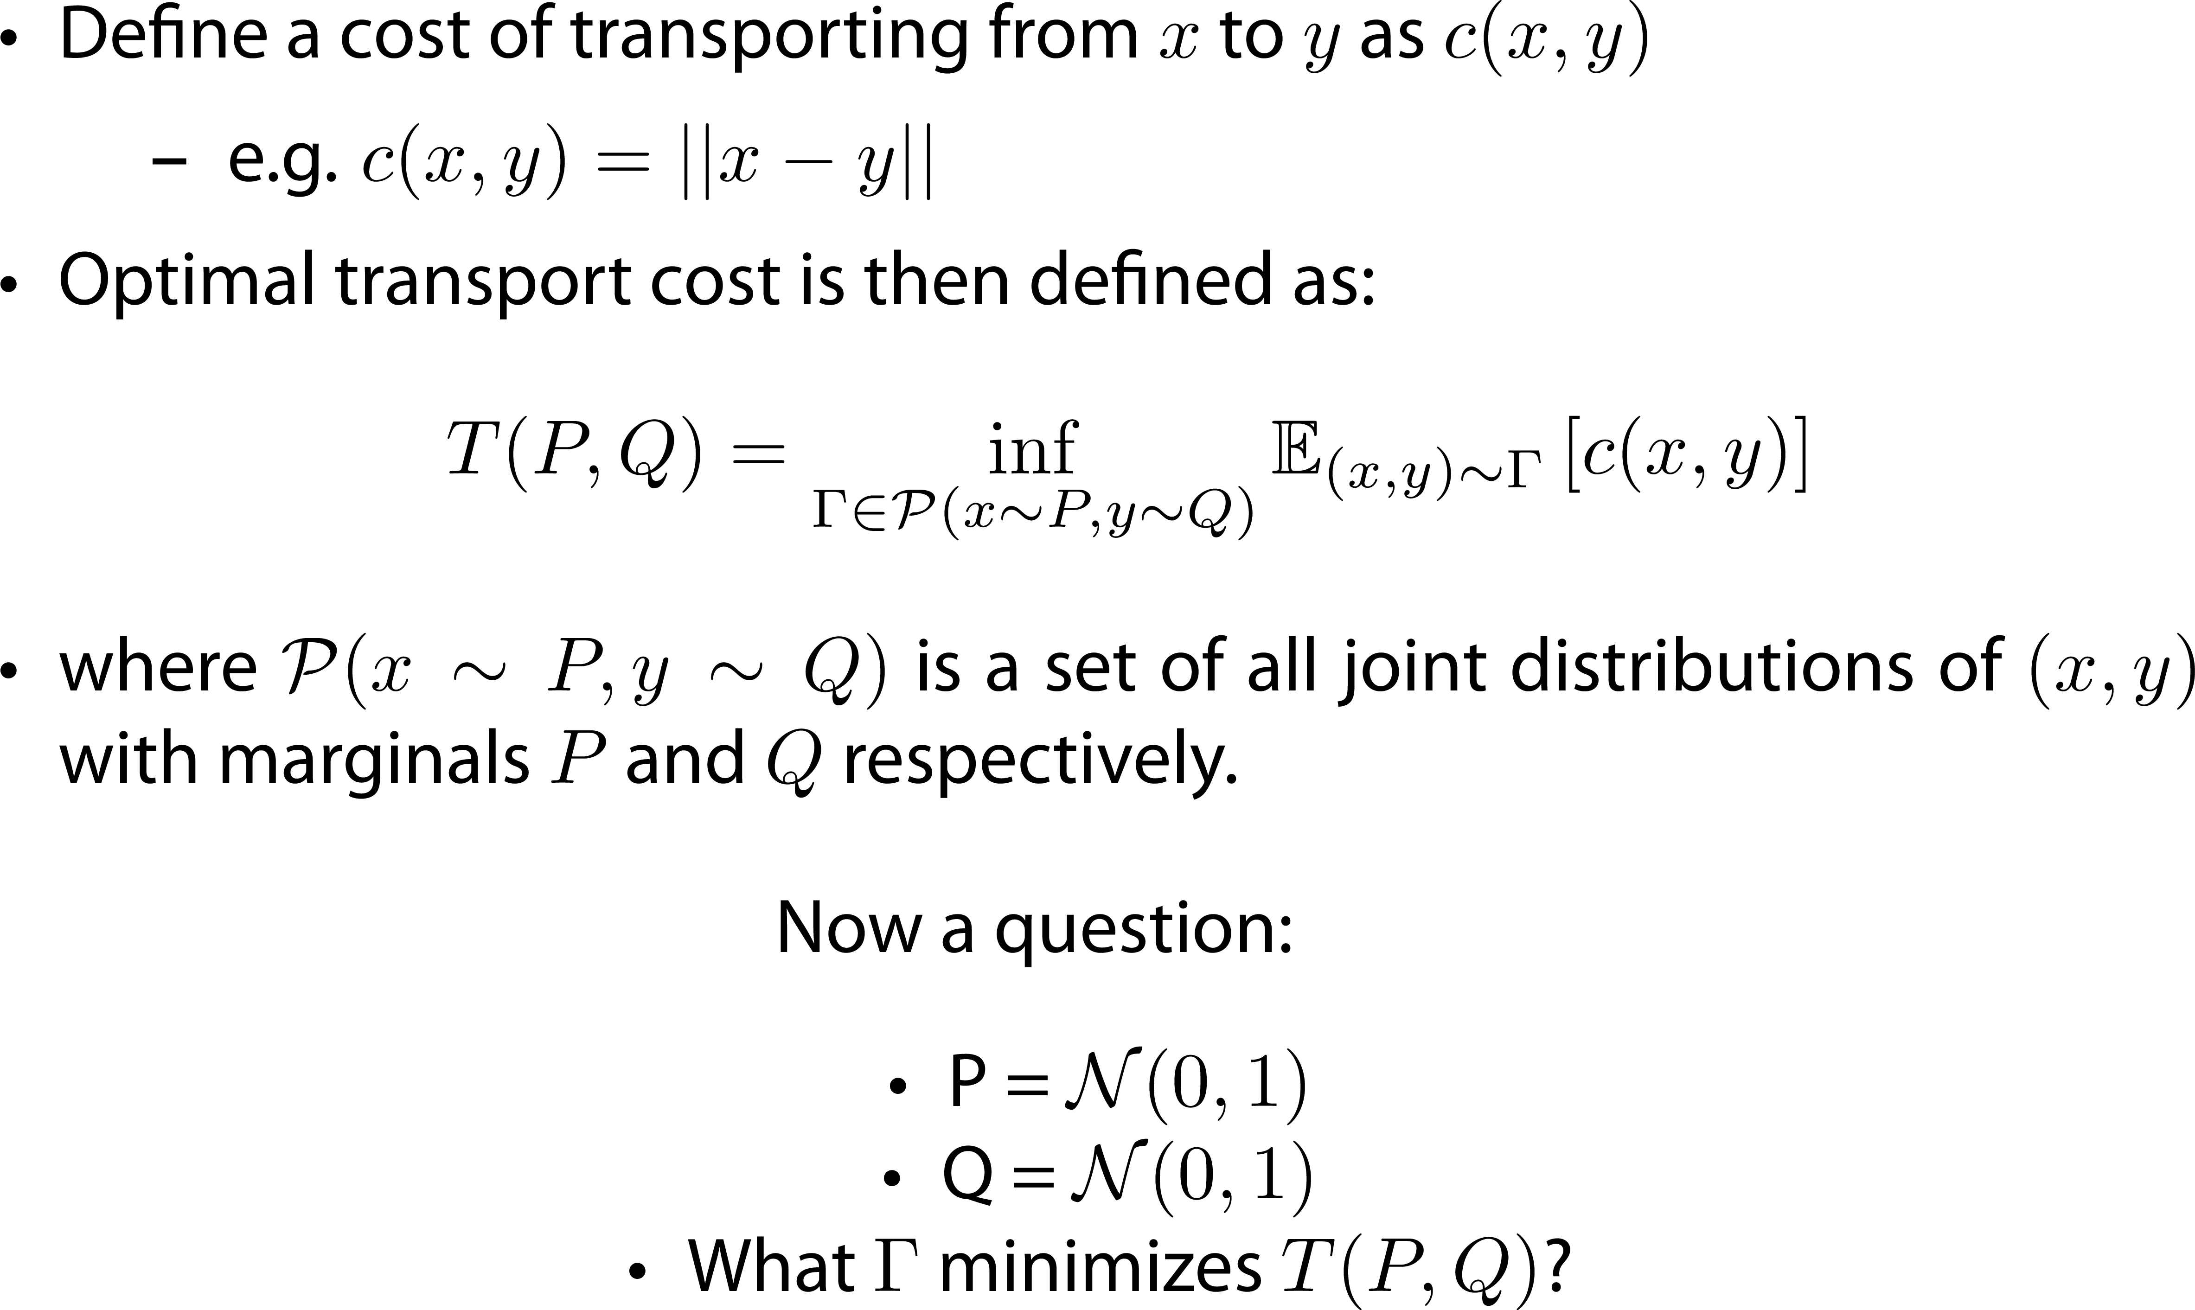
Optimal transport
Notes:
Замечания
1) scoring rule это …
2) Generative loss может быть другим

Slide 32
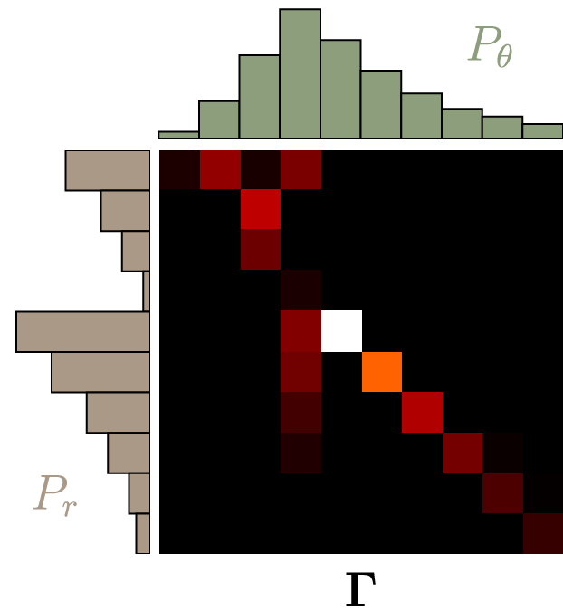
Optimal transport: example
Notes:
Замечания
1) scoring rule это …
2) Generative loss может быть другим

Slide 33
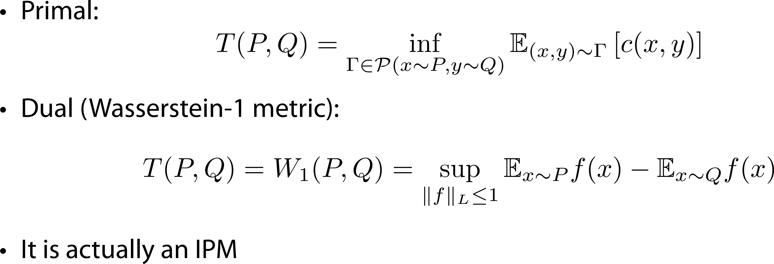
Optimal transport dual
Notes:
НАПИСАТЬ

Slide 34
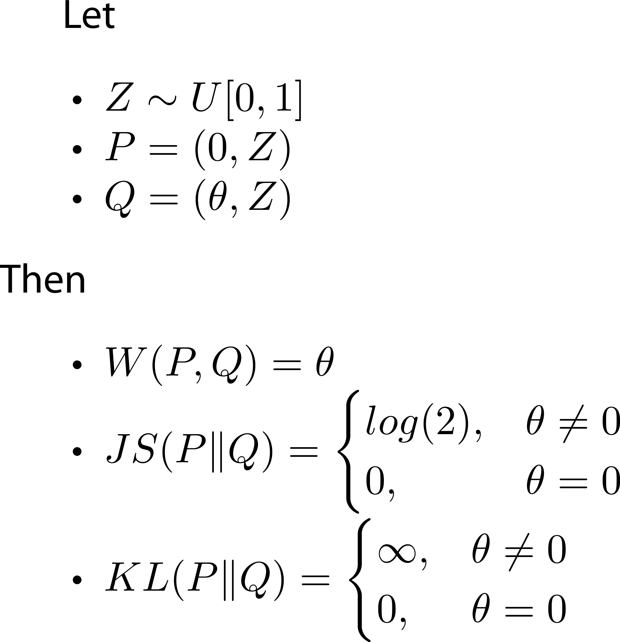
Optimal transport vs f-Divergence
Notes:
Замечания
1) scoring rule это …
2) Generative loss может быть другим

Slide 35
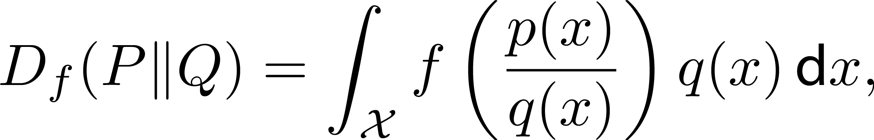



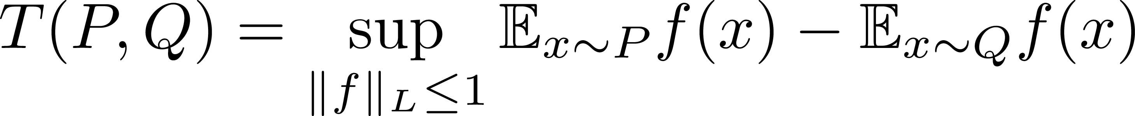
Divergences : summary
f-Divergences
Primal
Dual
IPMs
Optimal transport
Primal
Dual
Notes:
Замечания
1) scoring rule это …
2) Generative loss может быть другим

Slide 36
Outline
Vanilla GAN intuition
Distribution divergences
Learning in Implicit models
Alpha GAN

Slide 37
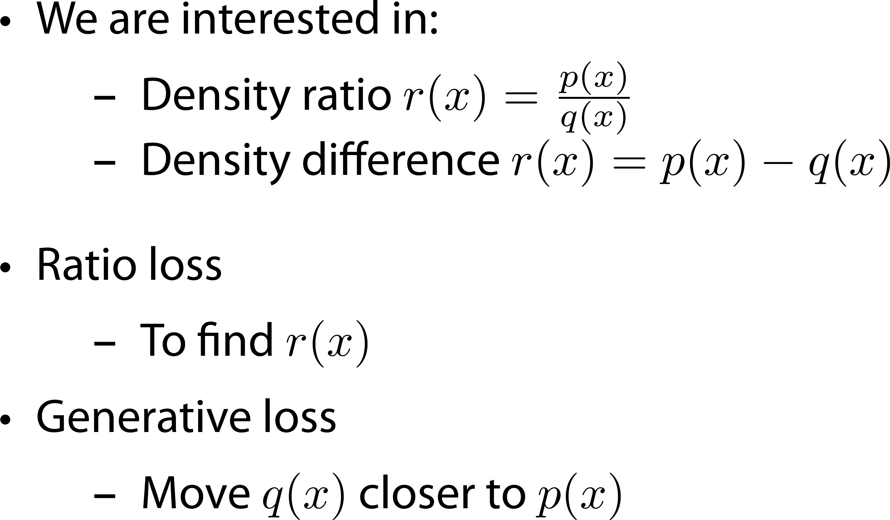
Learning in implicit models in general
Notes:
Implicit distributions are probability models whose probability density function may be intractable, but there is a way to
1. sample from them exactly and/or calculate and approximate expectations under them, and
2. calculate or estimate gradients of such expectations with respect to model parameters.

Slide 38
Learning in implicit models: plan
Class Probability Estimation
Divergence minimization
Ratio matching
Moment matching

Slide 39
Learning in implicit models: plan
Class Probability Estimation
Divergence minimization
Ratio matching
Moment matching

Slide 40
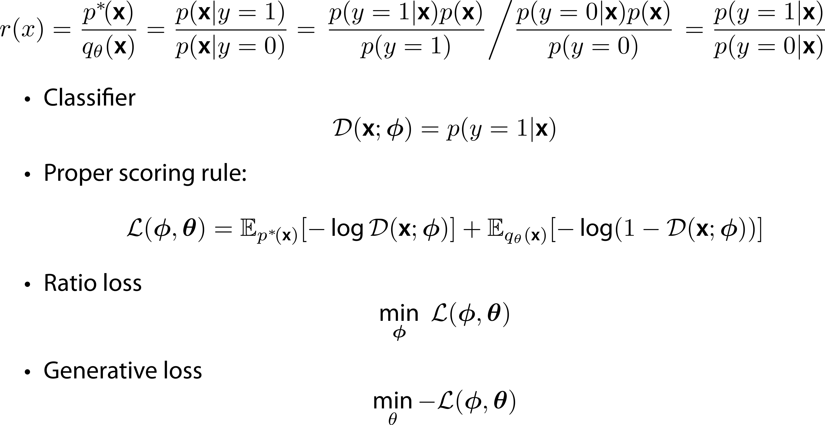
Class-probability matching
Notes:
Замечания
1) scoring rule это …
2) Generative loss может быть другим

Slide 41
Learning in implicit models: plan
Class Probability Estimation
Divergence minimization
Ratio matching
Moment matching

Slide 42
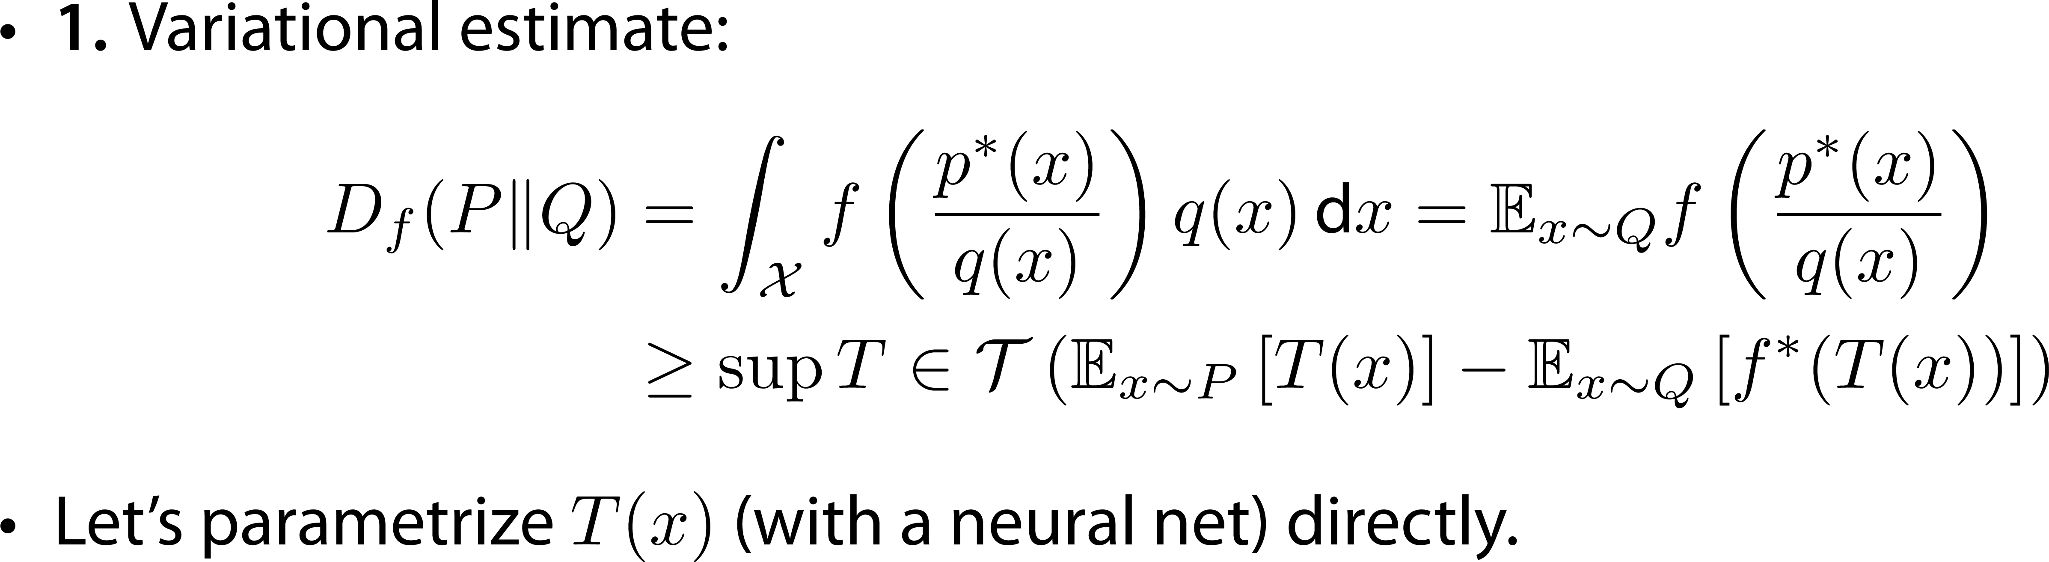
Divergence minimization I
Notes:
Замечания
1) scoring rule это …
2) Generative loss может быть другим

Slide 43
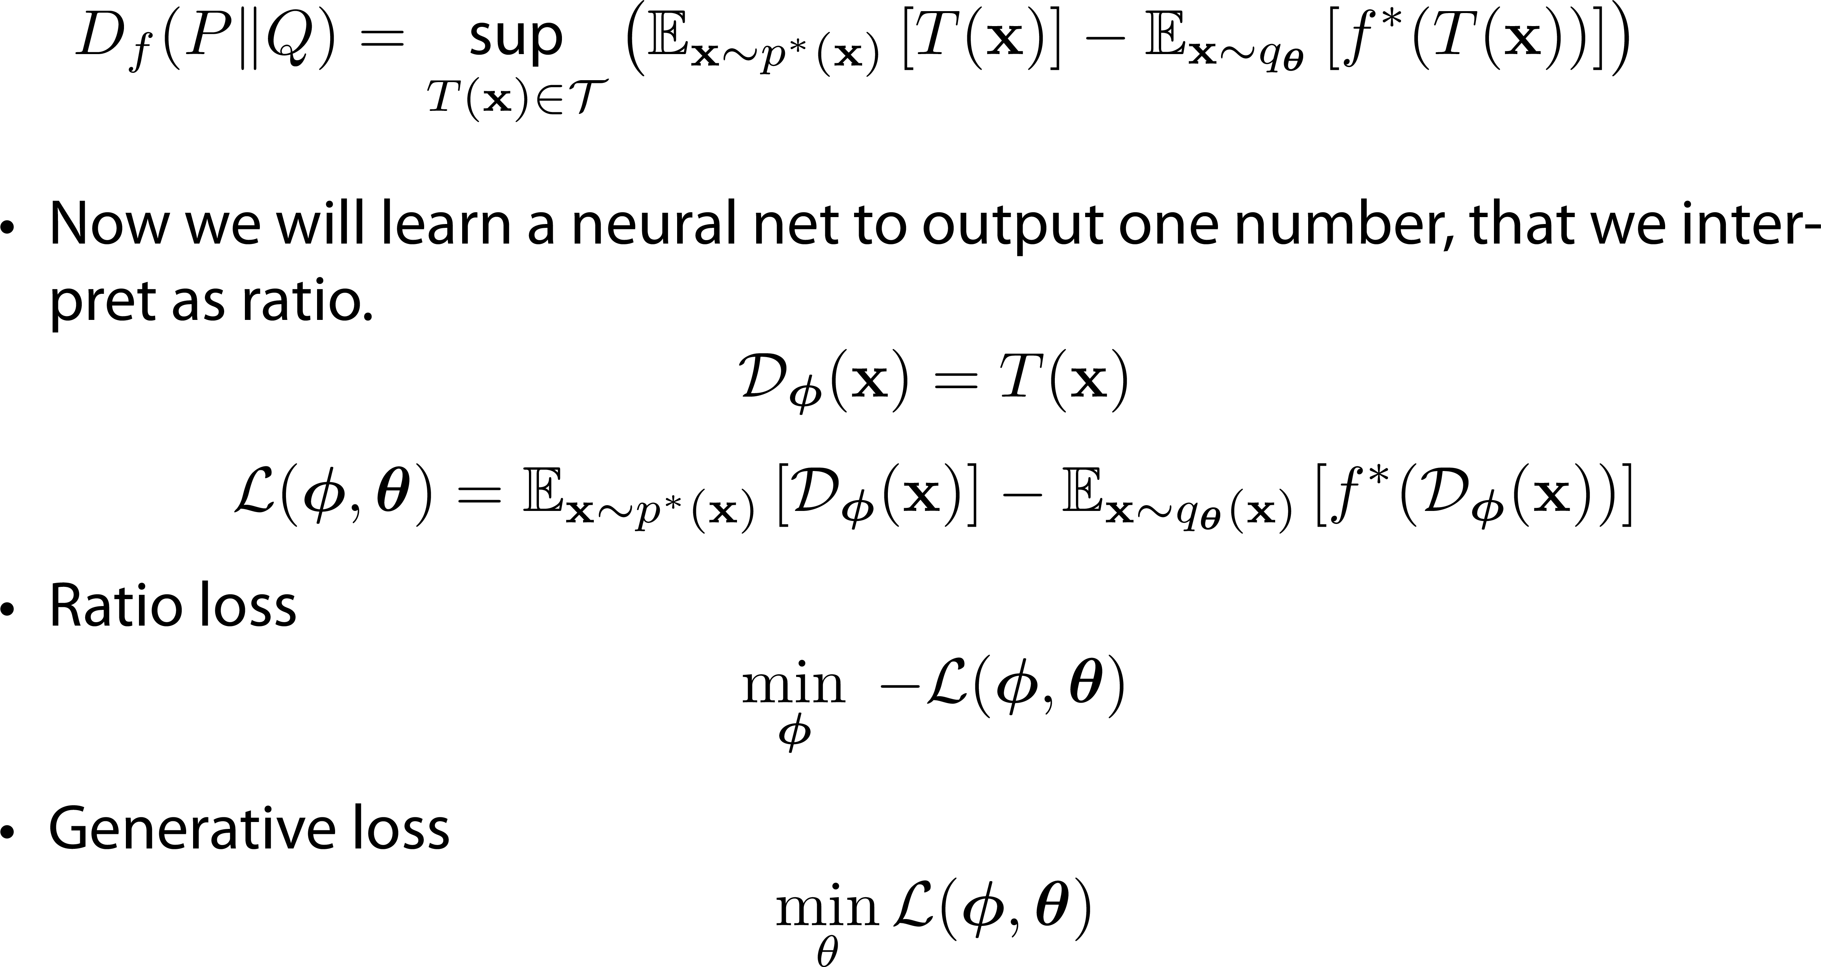
Divergence minimization I
Notes:
Замечания
1) scoring rule это …
2) Generative loss может быть другим

Slide 44
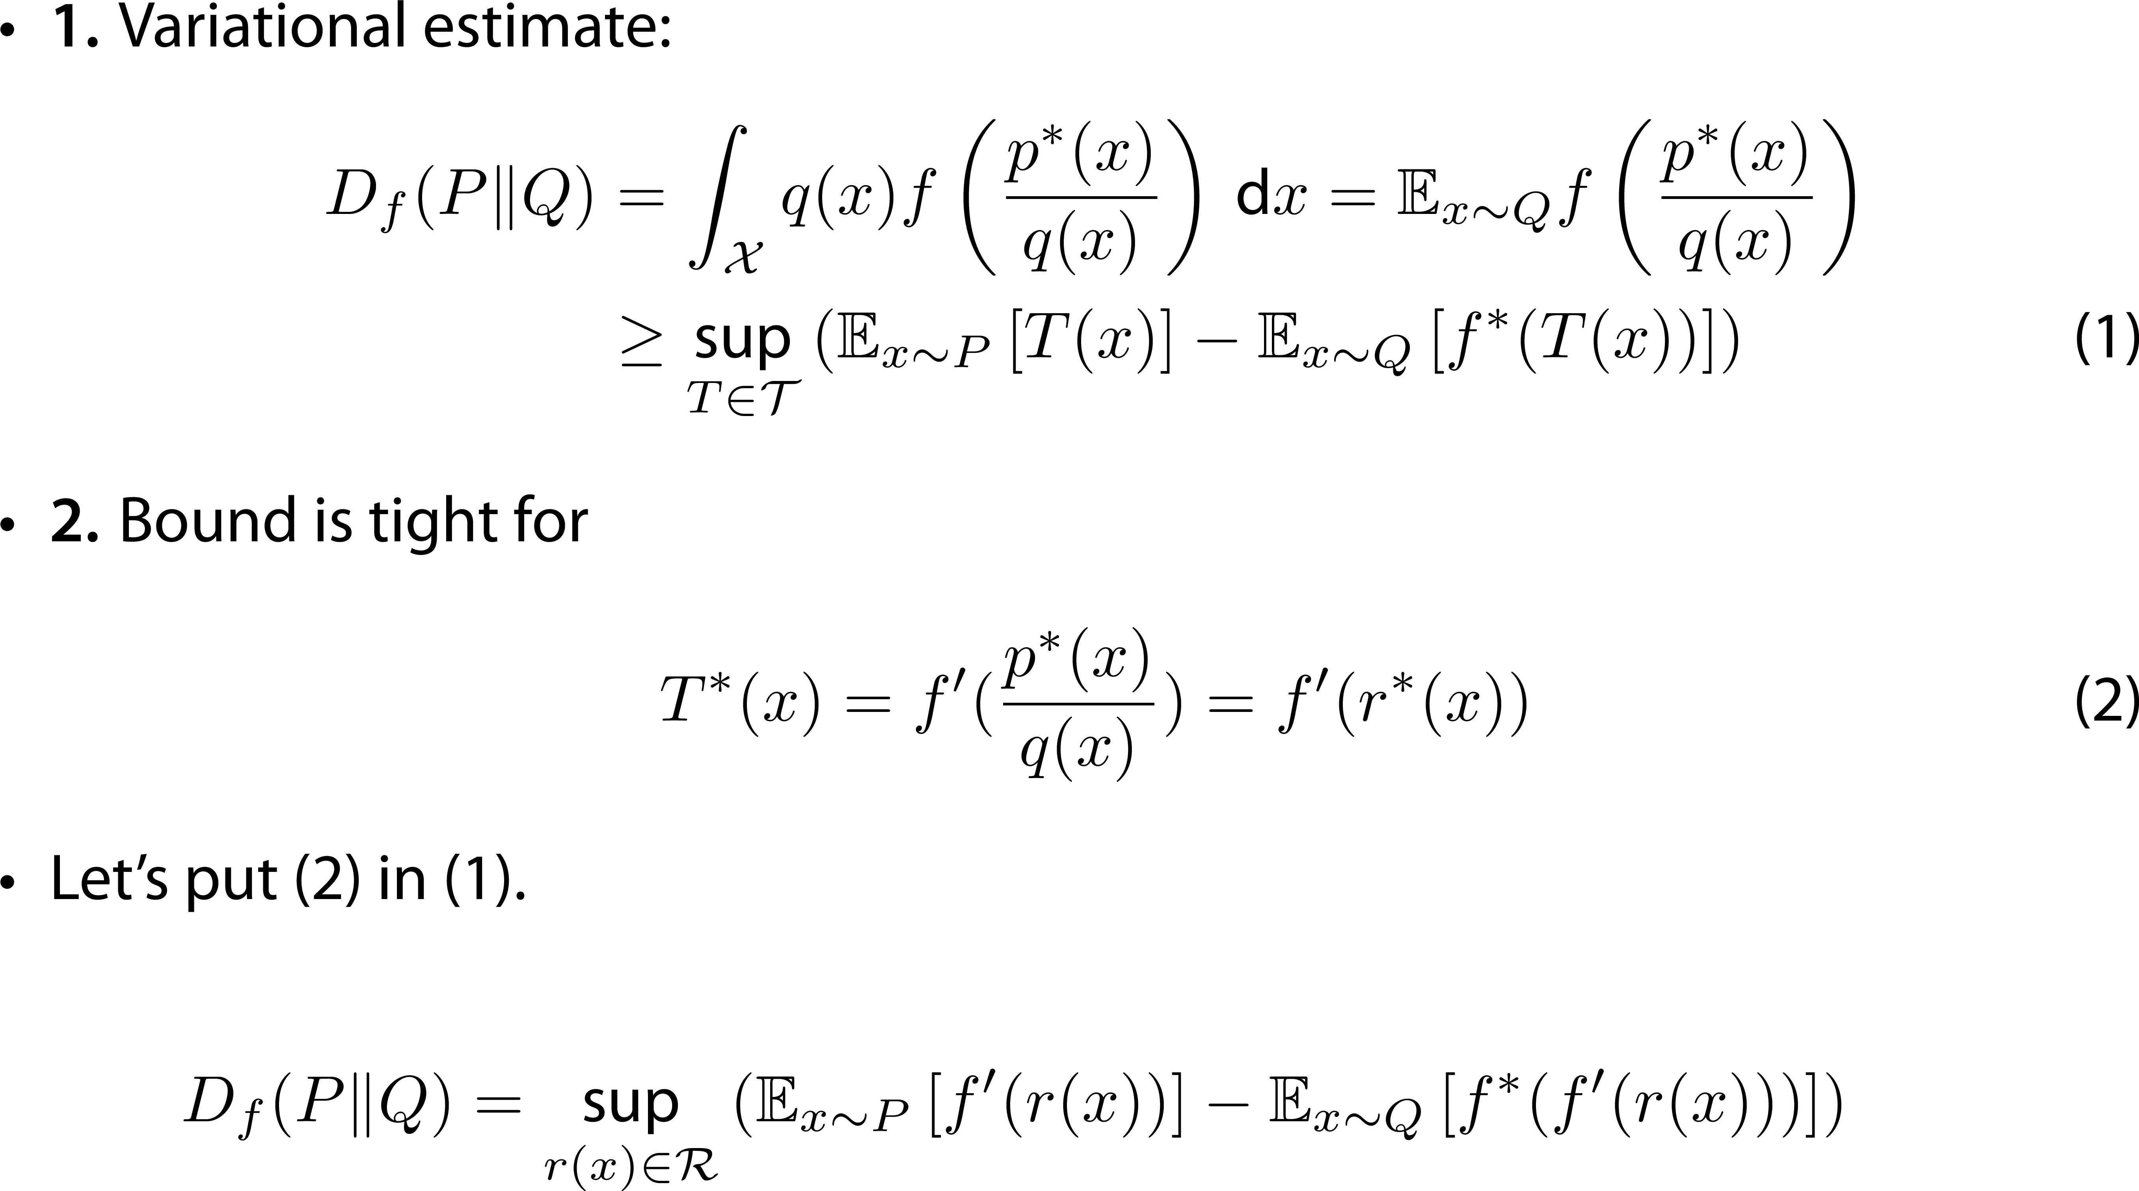
Divergence minimization II
Notes:
Замечания
1) scoring rule это …
2) Generative loss может быть другим

Slide 45
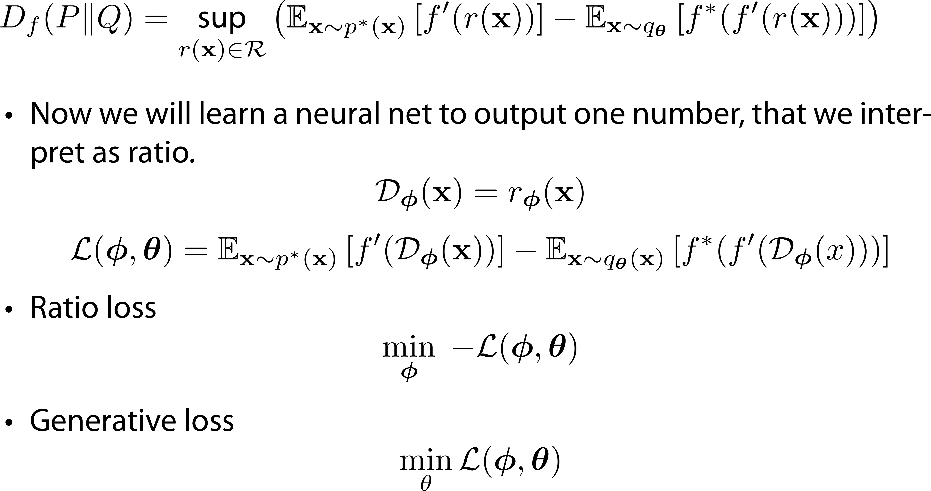
Divergence minimization II
Notes:
Замечания
1) scoring rule это …
2) Generative loss может быть другим

Slide 46
Learning in implicit models: plan
Class Probability Estimation
Divergence minimization
Ratio matching
Moment matching

Slide 47
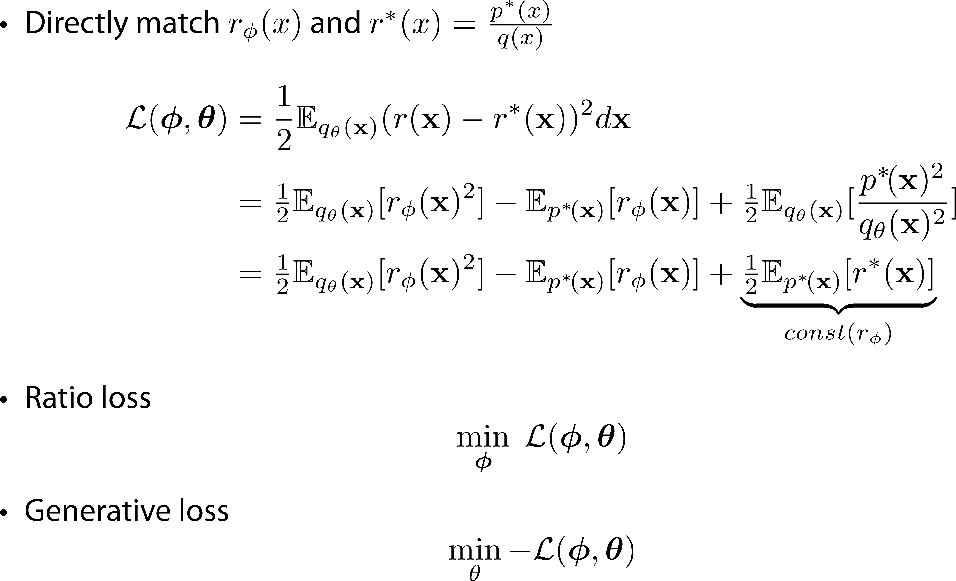
Ratio matching

Slide 48
Learning in implicit models: plan
Class Probability Estimation
Divergence minimization
Ratio matching
Moment matching

Slide 49
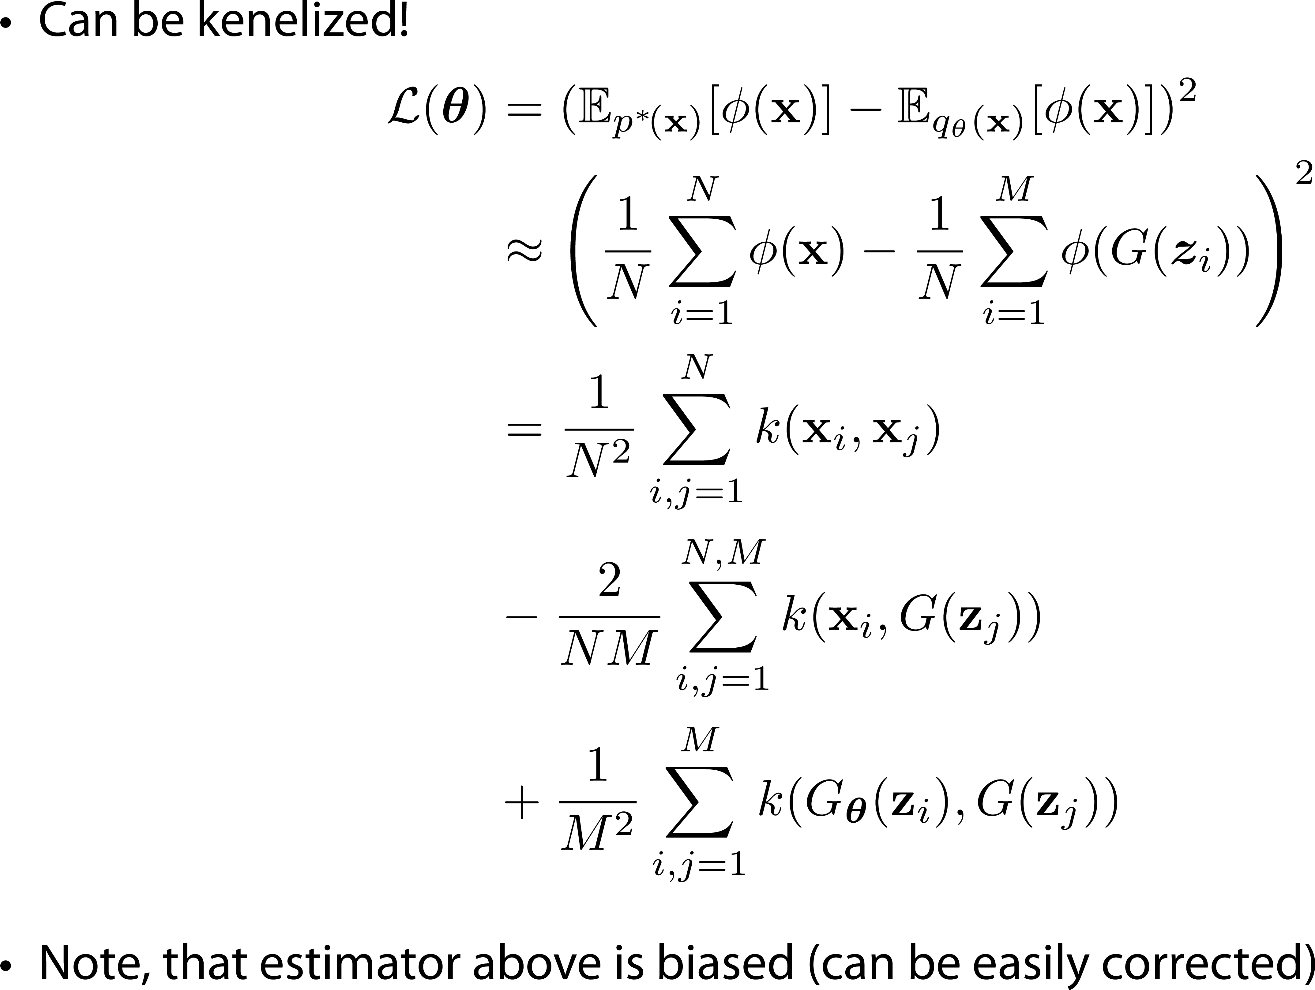
Moment matching

Slide 50
Outline
Vanilla GAN intuition
Distribution divergences
Learning in implicit models
Alpha GAN

Slide 51
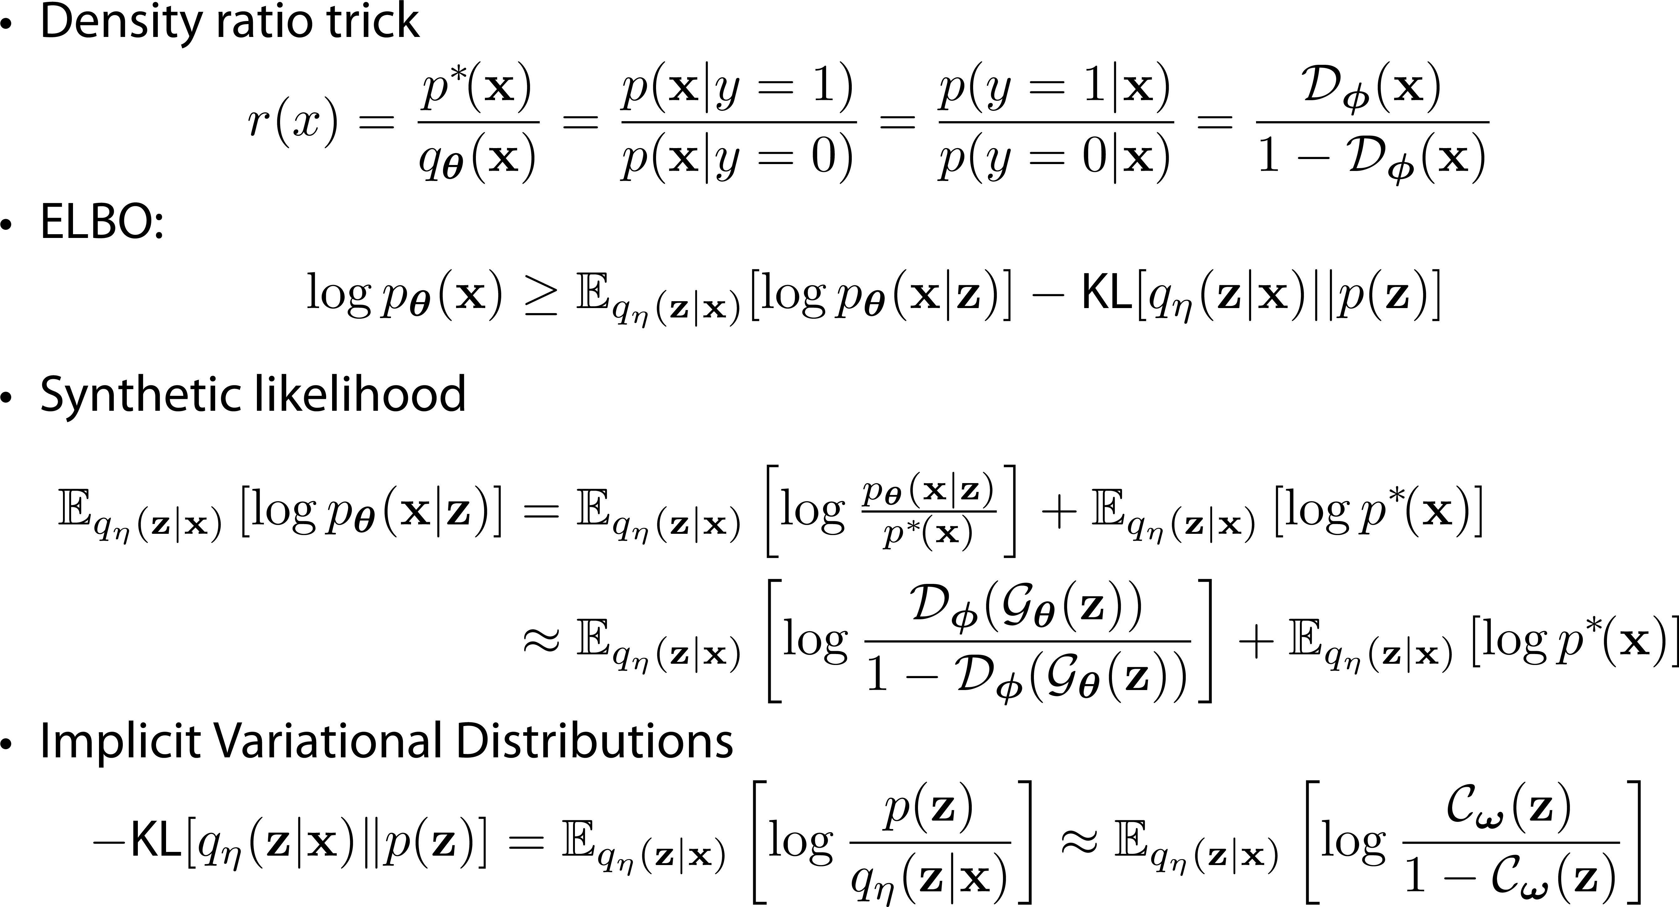
Alpha-GAN

Slide 52
References
Nowozin, Cseke, Tomioka. f-GAN: Training generative neural samplers using variational divergence minimization, 2016
Goodfellow et al. Generative adversarial nets, 2014.
Arjovsky, Chintala, Bottou. Wasserstein GAN, 2017.
Arjovsky, Bottou. Towards Principled Methods for Training Generative Adversarial Networks, 2017.
Ilya Tolstikhin, Implicit generative models: dual vs. primal approaches” slides , 2017
https://vincentherrmann.github.io/blog/wasserstein/

